Slide 1
Agreement Module
User Guide to Requesting NDAs/DUAs
January 2022

Slide 2
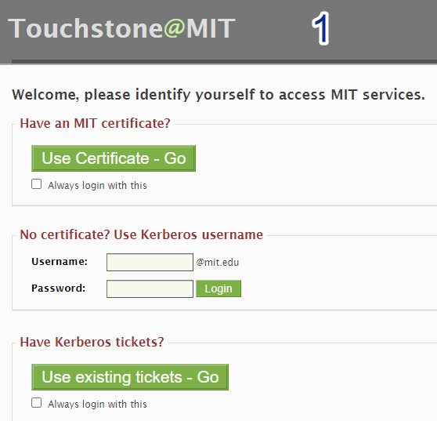
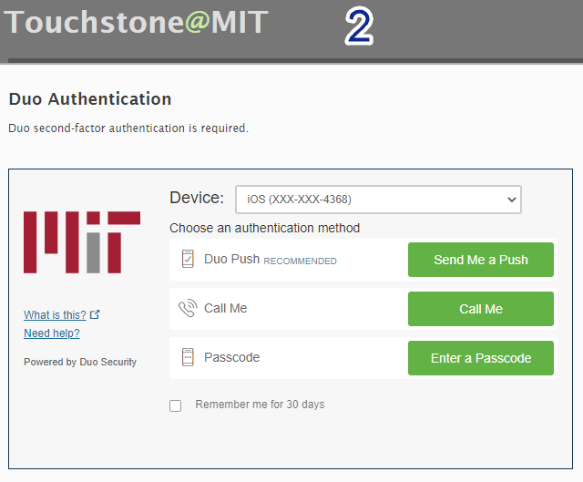
Accessing the Agreement Module
The Agreement Module is a web-based application and can be accessed via the NDA Portal https://nda.mit.edu, or via the Agreement Module directly at https://nda.mit.edu/fibi-agreement?url=fibi/dashboard/agreement-list.
Both access points require a Kerberos username/password.

Slide 3
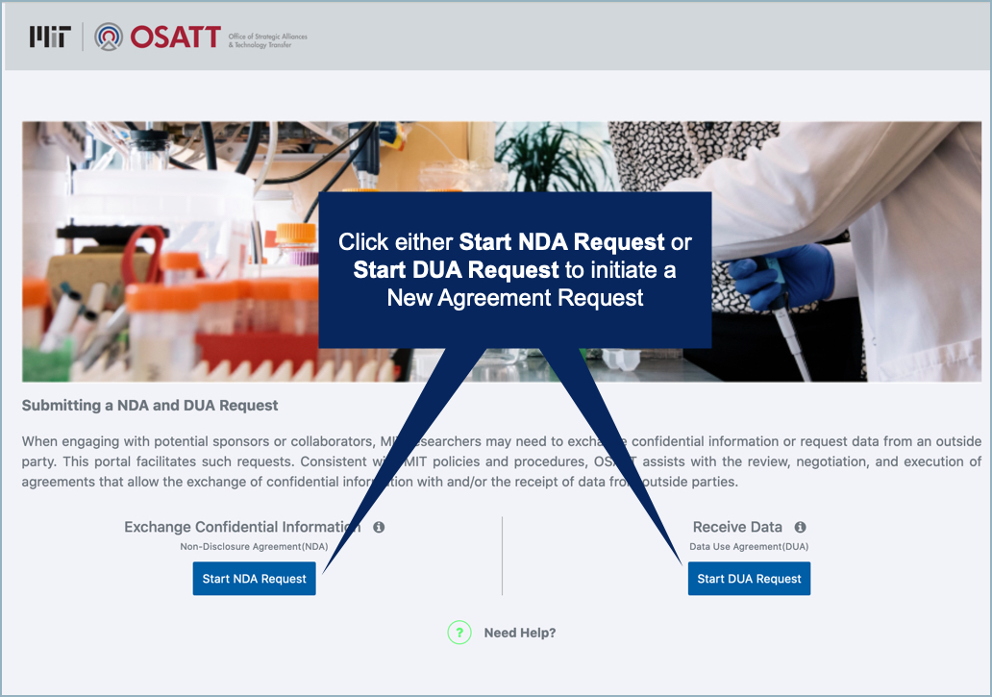
Initiating an Agreement Request via the NDA Portal: https://nda.mit.edu
Select Start NDA Request or Start DUA Request to initiate a new Agreement Request.

Slide 4
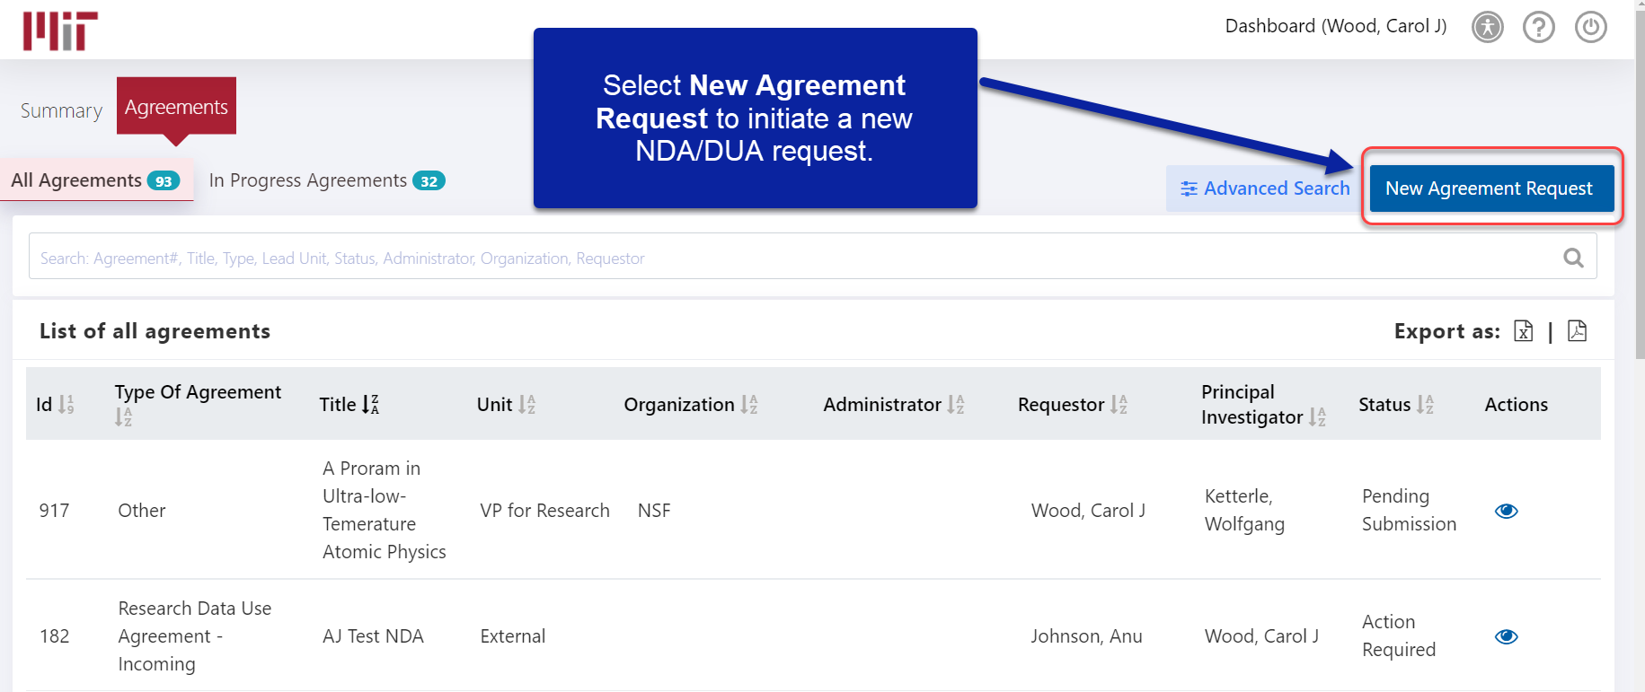
Initiating an Agreement Request via the Agreement Module:
https://ndaqa.mit.edu/fibi-agreement?url=fibi/dashboard/agreement-list
From the Agreement Tab, click on the New Agreement Request button to initiate entering a new NDA/DUA request.

Slide 5
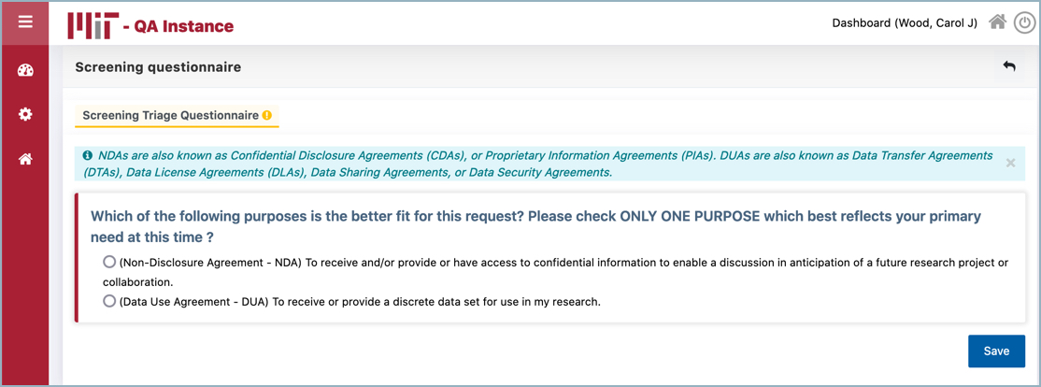
Screening Questionnaire – Only available if initiating from the Agreement Module
Select one of the screening questions from the Screening Questionnaire which most closely relates to your request and Save to proceed.

Slide 6
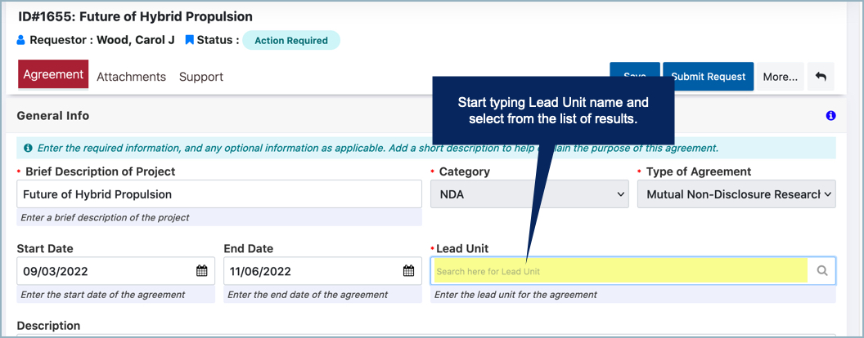
Agreement Module: General Info Section
Enter a Brief Description of Project, Start Date and End Date (if applicable), and Lead Unit.
Please see the next slide for a brief video demonstration of this feature (note: videos have no sound)

Slide 7
Agreement Module: Accessing via the NDA/DUA Portal Video
NOTE: Hover cursor over image for video controls at bottom of screen

Slide 8
Agreement Module – Initiating NDA/DUA, and Entering General Info Video
NOTE: Hover cursor over image for video controls at bottom of screen

Slide 9
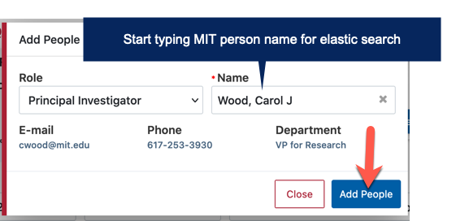
Agreement Module: Adding MIT People to the NDA/DUA Request
Enter MIT persons associated with this Agreement request under the People section of the Agreement tab.
Select Add People to add MIT persons to the Agreement request.
Select a person Role from the drop-down, search for the person Name and select Add Contact, and Save.
NOTE: At least one MIT PI must be included before the Agreement request can be submitted.
Please see the next slide for a brief video demonstration of this feature (note: video has no sound).

Slide 10
Agreement Module – Adding MIT People to the NDA/DUA Request Video
NOTE: Hover cursor over image for video controls at bottom of screen

Slide 11
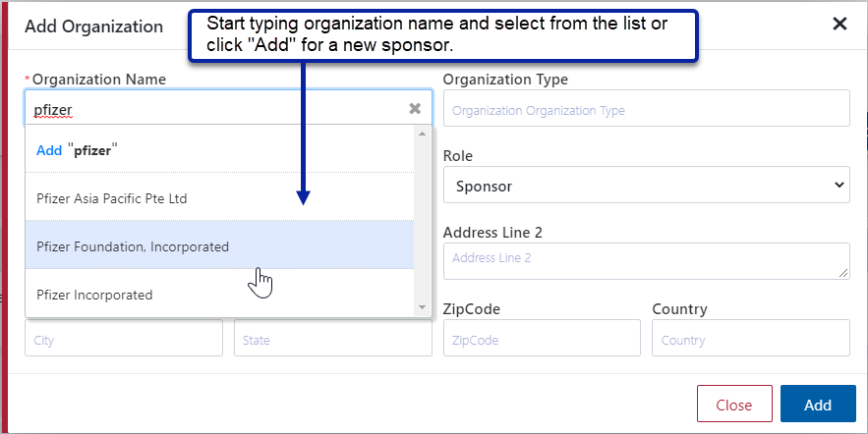
Agreement Module: Adding an Outside Organization
Enter the other organization associated with the NDA/DUA to the Other Organization section by selecting Add Organization.
Use the elastic search to type in the Organization Name and select Add for new.
NOTE: At least one Organization must be included before the request can be submitted.
Please see the next slide for a brief video demonstration of this feature (note: video has no sound).

Slide 12
Agreement Module – Adding an Organization Video
NOTE: Hover cursor over image for video controls at bottom of screen

Slide 13
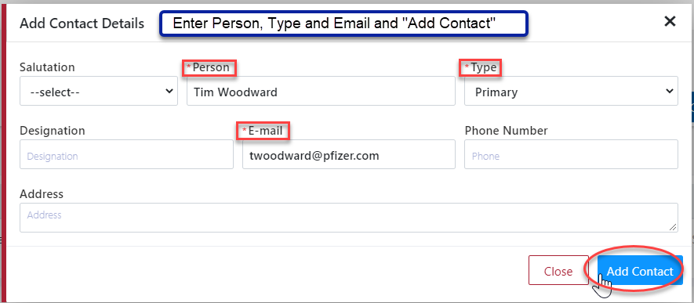
Agreement Module: Adding an Organization Contact
Enter a contact for the Outside Organization to the Outside Organization section by selecting
Manually enter the Person Name and Email.
Type will default to Primary for the first contact entered. Use drop-down to edit contact type.
NOTE: At least one Organization Contact must be included for each outside organization before the request can be submitted.
Please see the next slide for a brief video demonstration of this feature (note: video has no sound).

Slide 14
Agreement Module – Adding an Organization Contact Video
NOTE: Hover cursor over image for video controls at bottom of screen

Slide 15
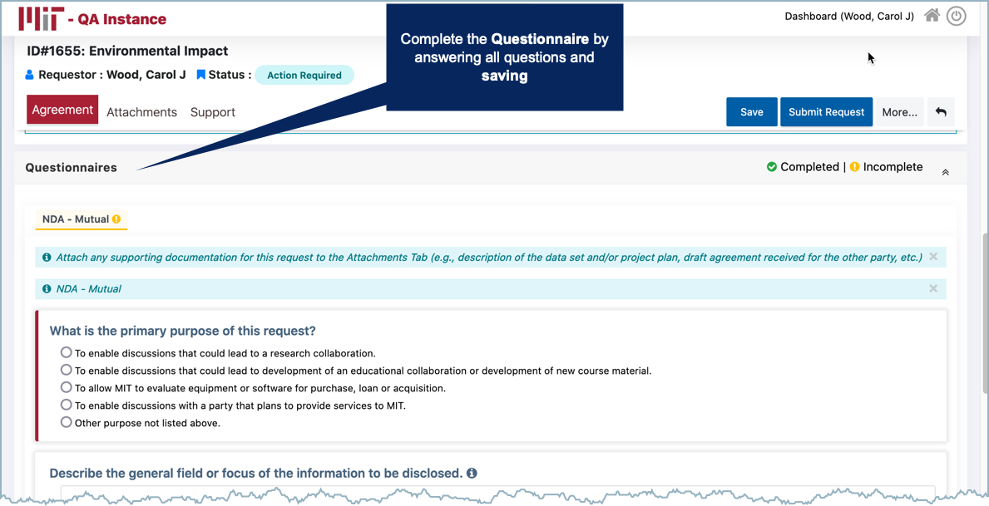
Agreement Module: Completing Required Questionnaire
Each NDA/DUA request requires one questionnaire to be completed.
Answer all questions in the Questionnaire section and Save.

Slide 16
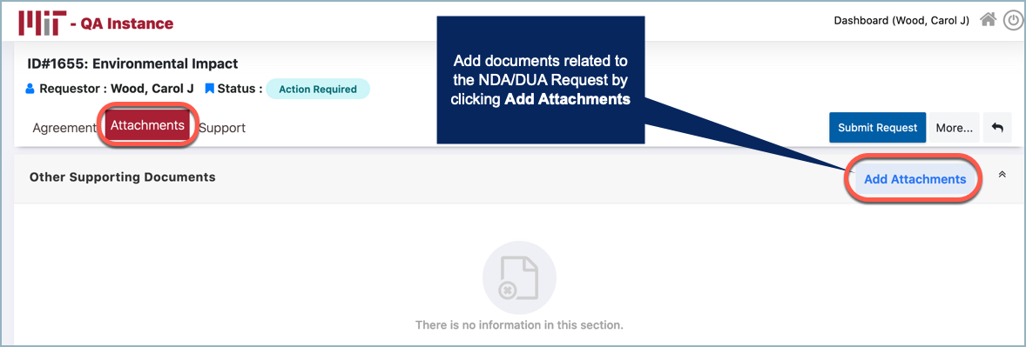
Agreement Module: Adding Attachments to the Attachments Tab
Add attachments to support the NDA/DUA request to the Attachments Tab.

Slide 17
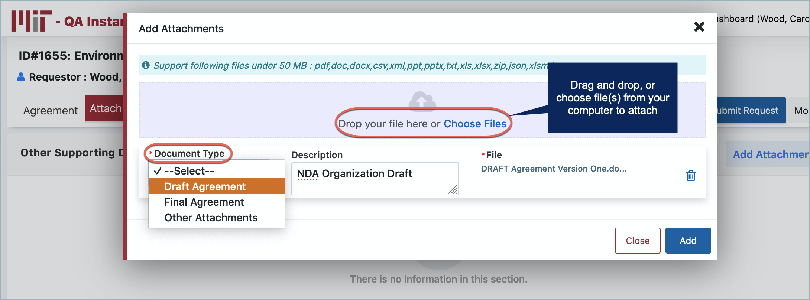
Agreement Module: Adding to the Attachments Tab Cont. Attachments
Drag and drop, or Choose Files to attach.
Select a Document Type and Add to continue. NOTE: Description is an optional field.
Please see the next slide for a brief video demonstration of this feature (note: video has no sound)

Slide 18
Agreement Module – Adding Attachments Video
NOTE: Hover cursor over image for video controls at bottom of screen

Slide 19
Agreement Module: Submitting the Request
Select Submit Request to Submit the Agreement Request.
NOTE: The Agreement Status changes from Pending Submission to Submitted.
Please see the next slide for a brief video demonstration of this feature (note: video has no sound)

Slide 20
Agreement Module – Submitting Request Video
NOTE: Hover cursor over image for video controls at bottom of screen

Slide 21
Agreement Module: Viewing Existing Requests
As a PI or Department Administrator, one has the ability to see the PI’s full list of agreement requests by clicking on View Existing Requests on the NDA/DUA Portal Landing page https://nda.mit.edu.
Please see the next slide for a brief video demonstration of this feature (note: video has no sound)

Slide 22
Agreement Module: Viewing Existing Agreements as PI – Video
NOTE: Hover cursor over image for video controls at bottom of screen

Slide 23
Agreement Module: Agreement Tab – Finding Your Agreements
The Agreement tab includes views for All Agreements and In Progress Agreements
All Agreements
In Progress Agreements
List of all agreements in-progress, submitted and finalized
List of agreements created, but not yet submitted

Slide 24
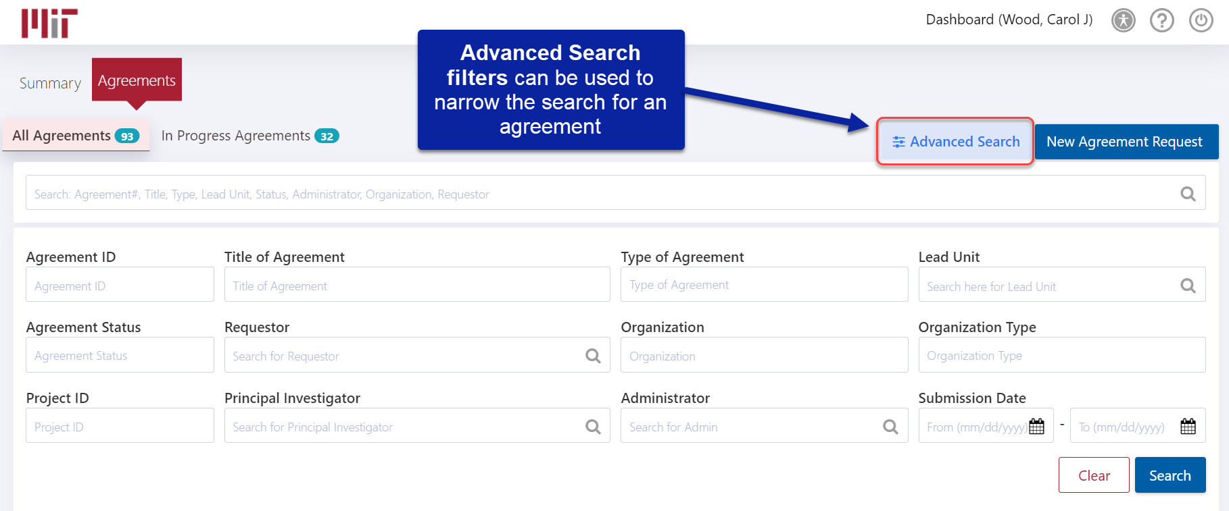
Agreement Module: Advanced Search – Finding Your Agreements
Use Advanced Search to filter search results.

Slide 25
User Support
Questions?
On-going Support
For technical help, contact Research Administration Services: RA-help@mit.edu
For NDA/DUA specific questions, contact the NDA/DUA Team: nda-dua-team@mit.edu

